Slide 1

Deep Learning Techniques For Breast Cancer Risk Prediction Using Python
Submitted by:Poonam.N.Tiwari
Reg No: 2016IEC12
College: Central University Of Karnataka

Slide 2
Introduction
Breast cancer is the second leading cause of cancer-related deaths, and the most commonly diagnosed cancer among women across the world.
Breast cancer is one of the leading causes in women.
Early detection and treatment are imperative for improving survival rates and to reduce the such kinds of hazards as mentioned above, which have steadily increased in recent years of more sophisticated computer-aided-diagonosis (CAD) systems.
A deep learning algorithm trained on a linked dataset of mammograms and electronic health records achieved breast cancer detection accuracy comparable to radiologists as defined by the Breast Cancer Surveillance benchmark for screening digital mammography and revealed additional clinical risk features.
Computational models based on deep neural networks are being increasingly used to analyze healthcare data. However, the efficacy of traditional computational models in radiology is still a matter of debate

Slide 3
Problem Statement
Breast cancer is the leading malignancy affecting women in the United States today, with over 180,000 women estimated to be diagnosed in 2008. It is the second leading cause of breast cancer mortality with over 40,000 women who will succumb to this disease.
Breast cancer is one of the main causes of cancer death worldwide. Early diagnostics significantly increases the chances of correct treatment and survival, but this process is tedious and often leads to a disagreement between pathologists. Computer-aided diagnosis systems showed potential for improving diagnostic accuracy. But early detection and prevention can significantly reduce the chances of death. It is important to detect breast cancer as early as possible.

Slide 4
Purpose
To evaluate the accuracy and efficiency of a combined machine and deep learning approach for early breast cancer detection, applied to a linked set of digital mammography images and electronic health records.
In this proposed system we are able to identify the rate of breast cancer. By prediction of Breast cancer in healthcare we are able to take suitable measures accordingly to control the cancer tissue. Due to the large size of each image in the training dataset, we propose a technique which consists of two consecutive convolutional neural networks. By using deep neural networks we are predicting the cancer is benign or malignant.Users have feasibility to upload scanned images on a web page to know about the status.

Slide 5
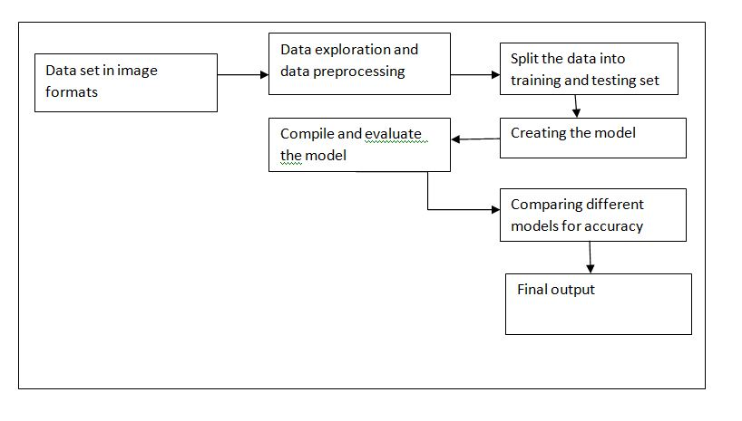
Proposed Solution

Slide 6
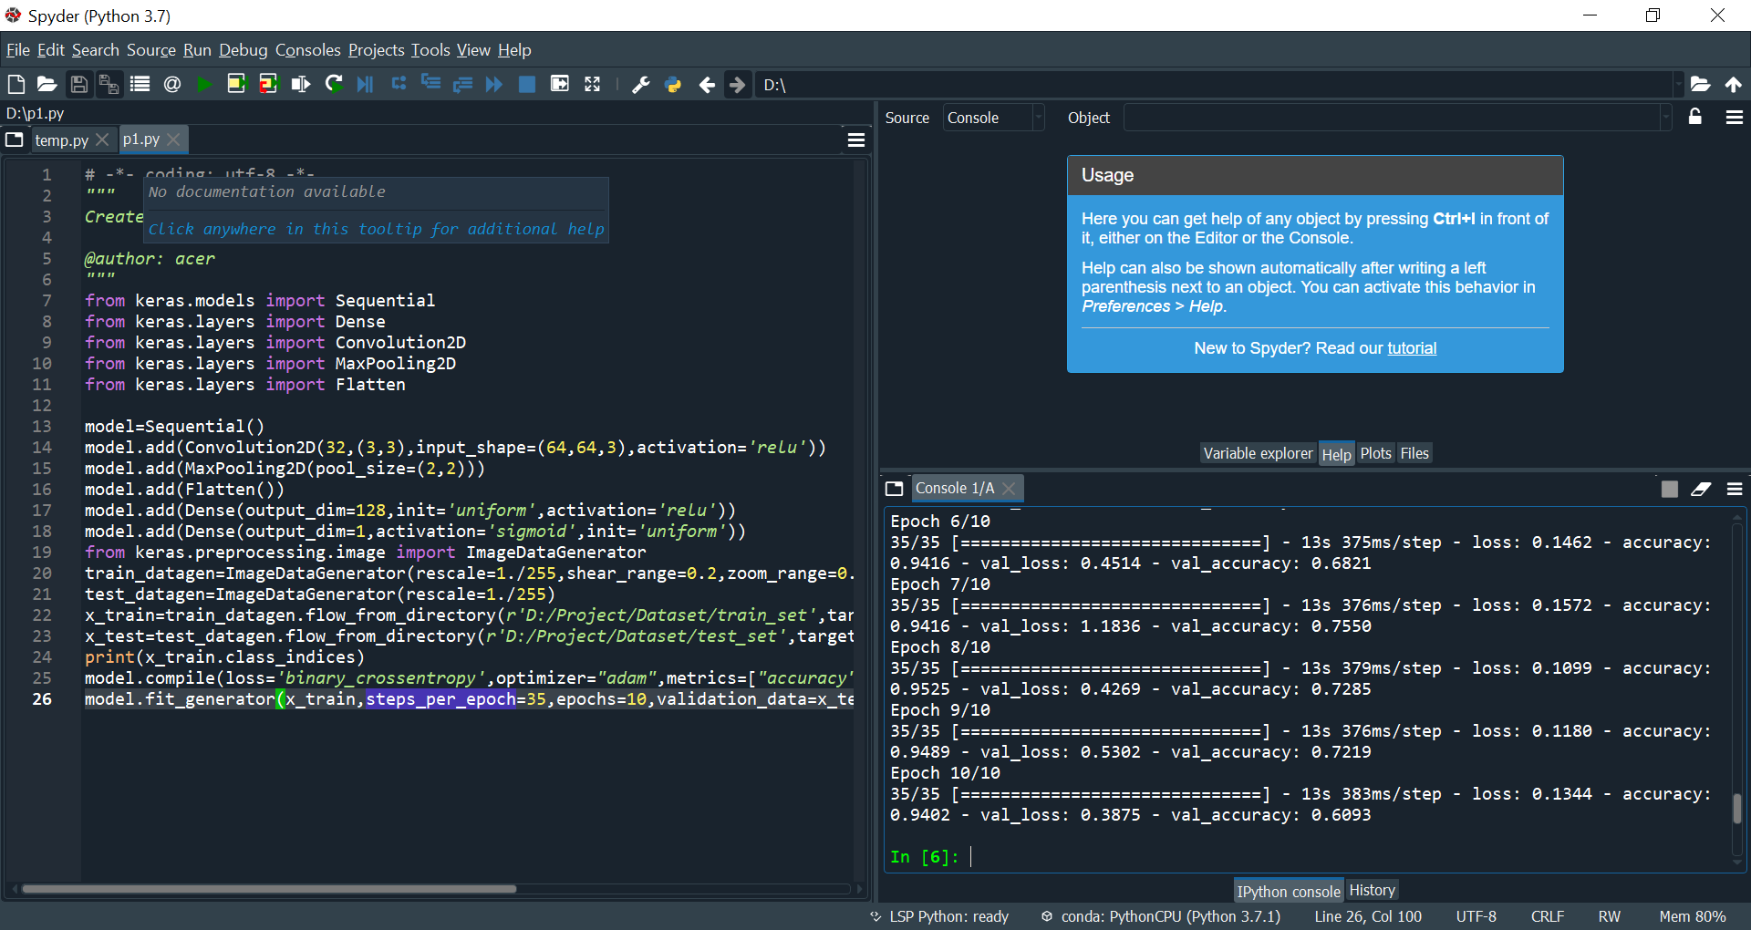
Outputs

Slide 7
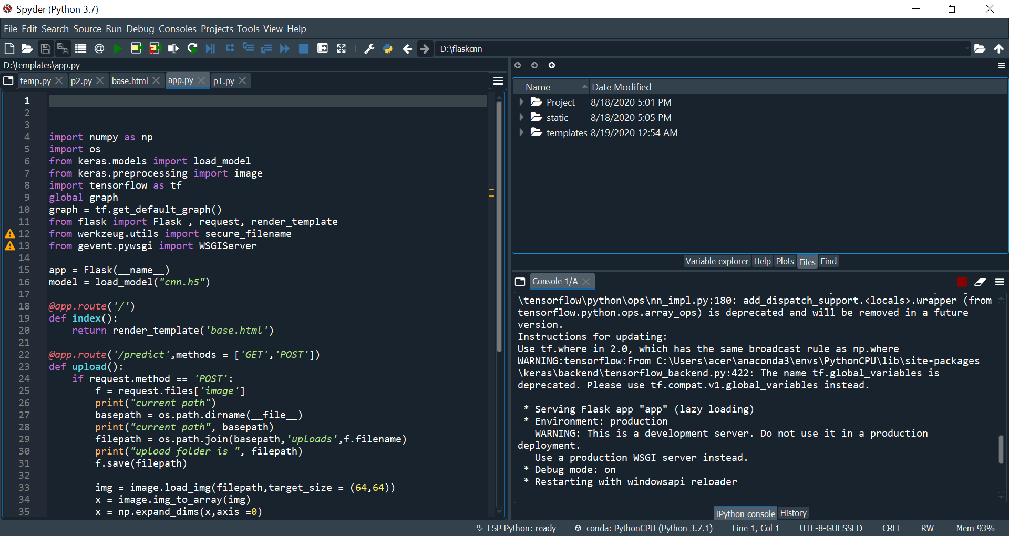

Slide 8
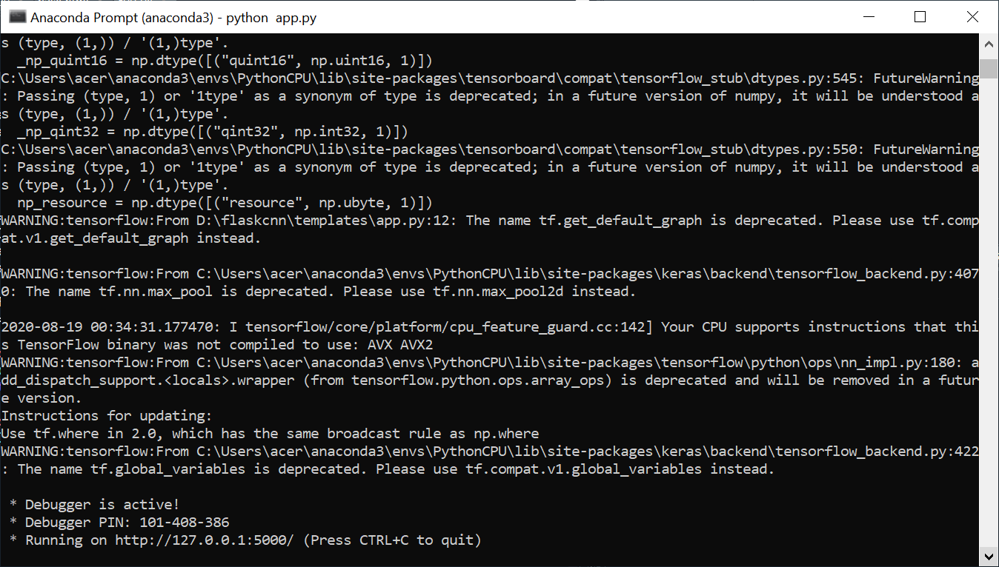

Slide 9
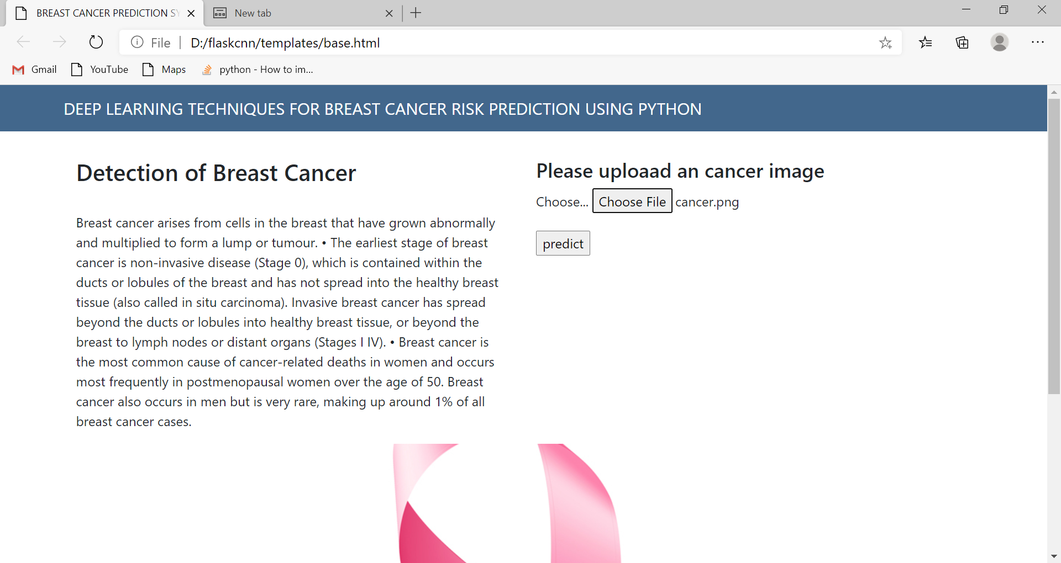

Slide 10
Application
1.Deep learning methods have enormous potential to further improve the accuracy of breast cancer detection on screening mammography as the available training datasets and computational resources expand.
2.Deep learning may assist future development of superior CAD systems that could be used to help prioritize the most suspicious cases to be read by a radiologist, or as an automatic second reader after making an initial independent interpretation.

Slide 11
Conclusion
In conclusion, project demonstrates that deep learning models trained in an end-to-end fashion can be highly accurate and potentially readily transferable across diverse mammography platform.
Deep learning methods have enormous potential to further improve the accuracy of breast cancer detection on screening mammography as the available training datasets and computational resources expand.In this project, the different deep learning and machine learning algorithms are studied to predict the breast cancer using different data sets and different deep learning algorithms. The accuracy depends upon the deep learning algorithms. Future work can be done to analyze the data set of breast cancer using deep learning classification algorithms because classification algorithms show better result than the clustering algorithms. To focus on the accuracy and precision, deep learning algorithms can show the better performance in predicting Breast Cancer. The project concludes that deep learning models give better accuracy compared to machine Learning Algorithms. Also the output is predictable in terms of probability in deep learning using Activation functions, which was not possible with machine learning algorithms.

Slide 12
THANK YOU

